Slide 1

“SECOND PHASE PRESENTATION” BACHELOR OF ENGINEERING IN COMPUTER SCIENCE AND ENGINEERING
POLYRECYCLER BIN
RECYCLE AND EARN
UNDER THE GUIDANCE OF : PROF. CHITRASHREE.K
PROJECT TEAM:
ASHWINI.T FALAQ.K PRADNYA.P
TRUPTI.H TRUPTI.M

Slide 2
CONTENTS:
1. INTRODUCTION
2. REFERENCES
2. ABSTRACTION
3. LITERATURE SURVEY
4. EXISTING SYSTEM
5. PROPOSED SYSTEM
6. SYSTEM DESIGN
7. REQUIREMENT SPECIFICATIONS
8. SCREENSHOTS
9. CONCLUSION AND FUTURE ENHANCEMENT

Slide 3

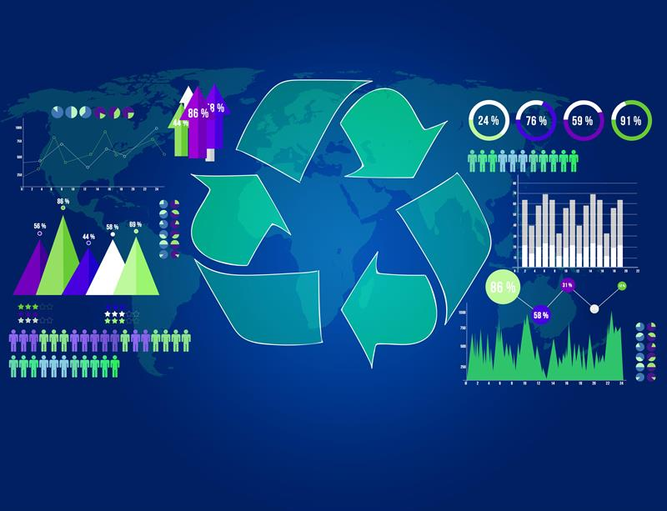
Introduction
Recycling is one of the important approaches taken for managing waste effectively. It is a process of collecting and processing unwanted materials to be turned into new products.
Recently, many countries are moving towards systematic techniques in managing waste. With the growth of the Information Technology, the trend is clear that the use of technology in managing waste is getting attention nowadays.
The utilization of techniques such as ,image processing, RFID can successfully indicate that technology is capable in providing a facility for the authority to manage waste effectively.

Slide 4
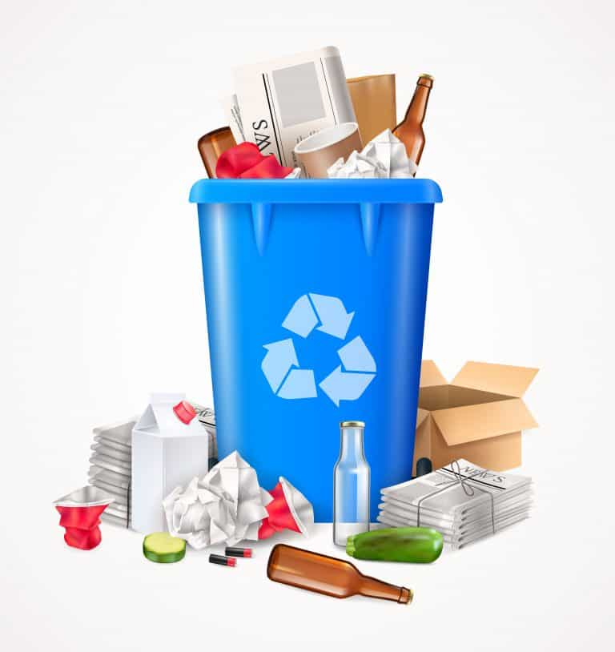
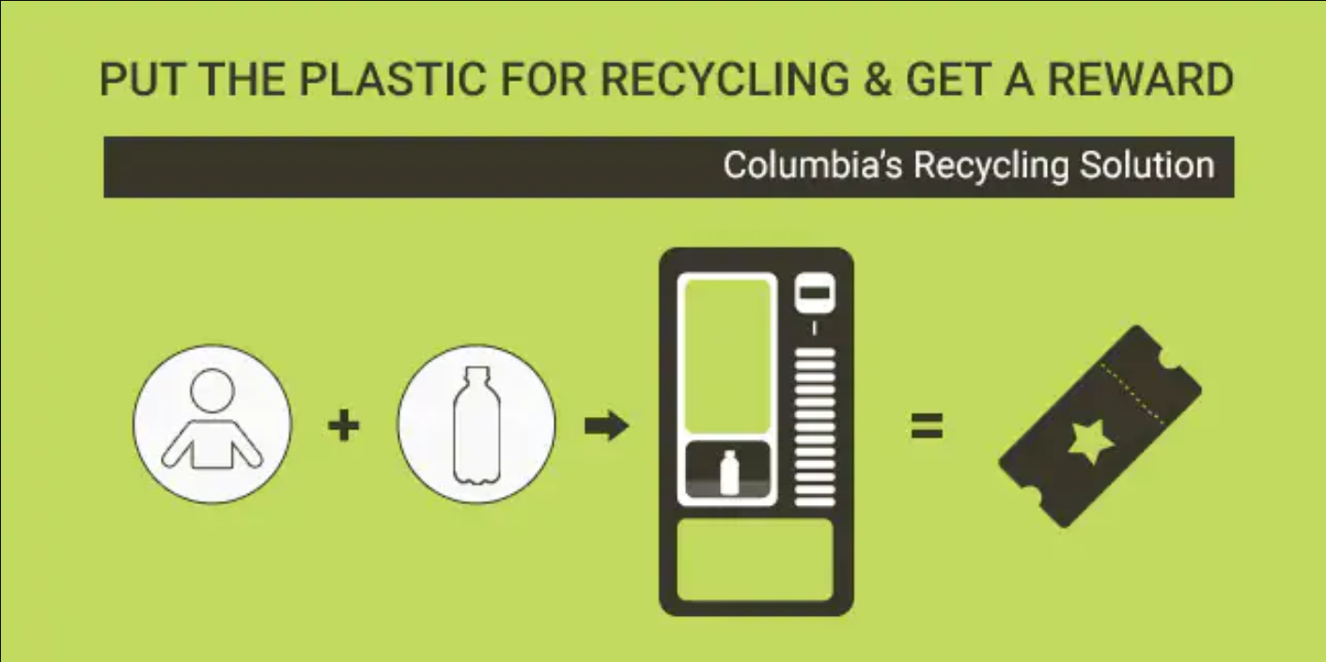
Our system implements the developed system into a standard recycle bin and maintaining the conventional procedure for the user to dump the waste. Our product evaluates the dump waste according to its weight, type, number and shape of the recycle waste.
This will benefit the users as well as the authorities that involved in waste management as all the transactions will be recorded in archive of this automated system.
Apparently, this product will emerge “waste to wealth” concept by motivating and encouraging people to recycle as they will be rewarded and eventually increase their awareness on the importance of waste recycling.

Slide 5
REFERENCES:
Maofic Farhan Karin, Khandaker Sharif Noor, Hasan U. Zaman Department of Electrical & Computer EngineeringNorth South University “Hardware Based Design and Implementation of a Bottle Recycling Machine using FPGA”proceedings of 978-1-5090-1181-0/16/$31.00 ©2016 IEEE.
Muhammad Ali Qureshi, Abdul Aziz & Hafiz Faiz Rasool “Design and Implementation of Automatic Ticket Systemusing Verilog HDL” proceedings of international conference on Information Technology, pp- 707-712 IPCSIT vol.17 (2011) © (2011) IACSIT Press, Singapore.
Seyed Bahram Zahir Azami & Mohammad Tanabian “Automatic Mobile Payment on a non- Connected VendingMachine” proceedings of Canadian Conference on Electrical and Computer Engineering, May 2004, pp- 731-734 Niagara Falls, Ontario,Canada.
K. Martinko, "Pay for your subway ride in Beijing by recycling a plastic bottle",TreeHugger, 2014. [Online].Available: http://www.treehugger.com/culture/pay-your-subway-ride-beijingrecycling- plastic-bottle.html.
[Accessed: 05-Jan-2016].
s

